Slide 1



Infrastructure & Application Monitoring
Victor Grazi
Nomura Securities
Infrastructure Software Development
Notes:
It’s pretty important to have monitoring going on in your application. You generally want to have visibility into your application to see what’s happening inside.
There is a great open source tool called Prometheus, for doing those kinds of jobs, and we will be talking about that today
I’m Victor Grazi, and I lead the Infrastructure Development Team for the business unit currently known as EIS

Slide 2
Prometheus – Scope for Today
What is Prometheus?
Architectural components
Node Exporter
AlertManager
Push gateway
Webhooks
Grafana
Instrumentation
Expression browser
PromQL
Counter
Gauge
Histogram
Summary
Exposition – publishing your metrics to Prometheus
Alerting
Metrics naming
Labels
Notes:
Today we are going to look into what is Prometheus
• There are a few simple pieces that comprise Prometheus, which we will discuss.
• Also there is the PromQL query language, which you can’t really say is SQL-Like, but once you get the hang of it, it is great for building time-series queries.
• we will cover the topic of exposition, how applications can expose their metrics to Prometheus,
• and finally we will have a look at work being done at Nomura to evaluate Prometheus and Grafana for use internally

Slide 3

What is Monitoring?
Metrics – Forensic analysis and SRE forecasting.
Alerting – Notify the right folks when things go wrong.
Logging – Strategic logging into a centralized store.
Tracing – What was the path of the rogue request and supporting data?
In production systems, things go wrong.
When they do, we want to know about it as early as possible…
And even earlier!
Notes:
So what is monitoring? If you ask ten people you will get 15 different answers. So let’s define it, and see how it aligns with Prometheus
Alerting – when things go wrong, who do we have to notify?

Slide 4
What is Prometheus?
Prometheus is an open source, metrics-based monitoring system.
Has a simple, powerful data model and query language.
Analyze how your infrastructure and applications are performing.
Each time-series has a name and an unordered set of key-value pairs called labels.
PromQL query language aggregates across any label, so you can analyze per process, per datacenter, per service, etc.
Time-series metrics can be graphed in dashboard systems such as Grafana.
Define alerts using the exact same PromQL query language that you use for graphing.
Notes:
So that’s monitoring. But what is Prometheus

Slide 5
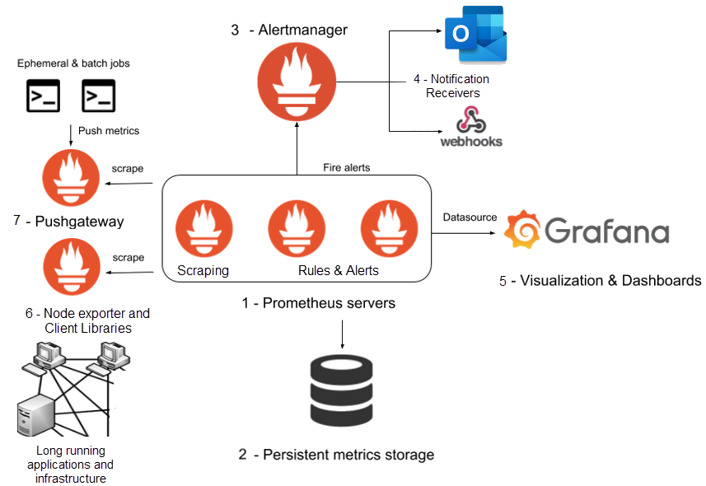
Prometheus Stack Architecture
Notes:
The time series DB is the secret sauce of Prometheus
heavy lifting can be done with Grafana, which generates some really nice graphs

Slide 6

Pull-based Monitoring
Prometheus uses a pull model, so you need to expose the metrics you want to expose, and configure Prometheus to scrape those at regular intervals.
Consists of:
Scheduler
Time-series database
AlertManager
Lightweight server
API endpoint for executing PromQL queries
Web-based admin server
Large community of exporters and a large corpus of exporters for infrastructure, middleware, cloud services, etc.
Client libraries in every major language, including Java, Node, Python, Go, etc. for collecting runtime metrics and custom application metrics

Slide 7
Downloading and configuring Prometheus and its components
Entities, (or “Targets”) export time series metrics in Prometheus format
“Scrapers” pull from targets at a configurable schedule. (YAML configuration files)
Notes:
The 4 Types Of Prometheus Metrics – Tom Gregory – has great examples of Java client library calls. Lists good general use cases.

Slide 8
prometheus_notifications_total process_cpu_seconds http_request_duration_seconds node_memory_usage_bytes http_requests_total process_cpu_seconds_total
Metrics Naming
Prefix – Application or entity name
Followed by – Metric descriptive name (e.g. cpu, notifications, queue_size)
Suffix – Unit of measure (in plural)
Aggregate metric will have an additional suffix

Slide 9
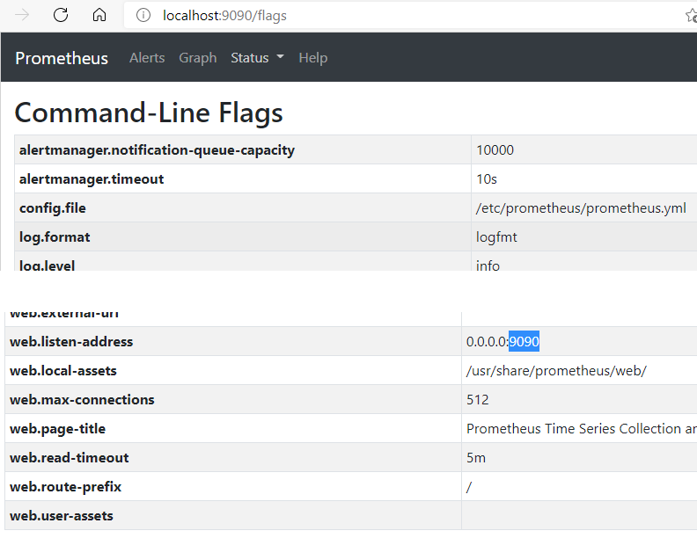

. . . . .

Slide 10
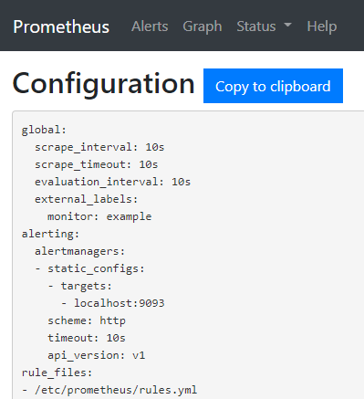
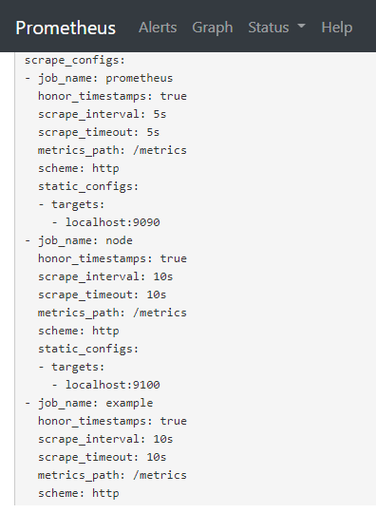

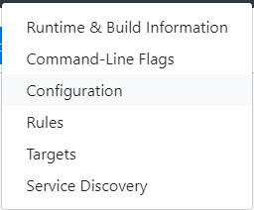
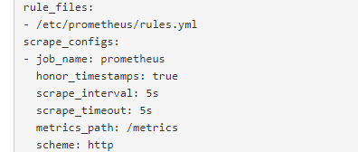
Notes:
navigate to localhost:9090 for Prometheus
navigate to localhost:9090/metrics – Prometheus exports its own metrics in Prometheus format (Prometheus is written in Go, so many Go related metrics)
navigate to localhost:9100/metrics for node exporter
Navigate to Status, then command line, config, and targets
If config changes, you can manually set a reload, or you can have it automatically reload, without restarting Prometheus
Service Discovery, including file based or DNS

Slide 11
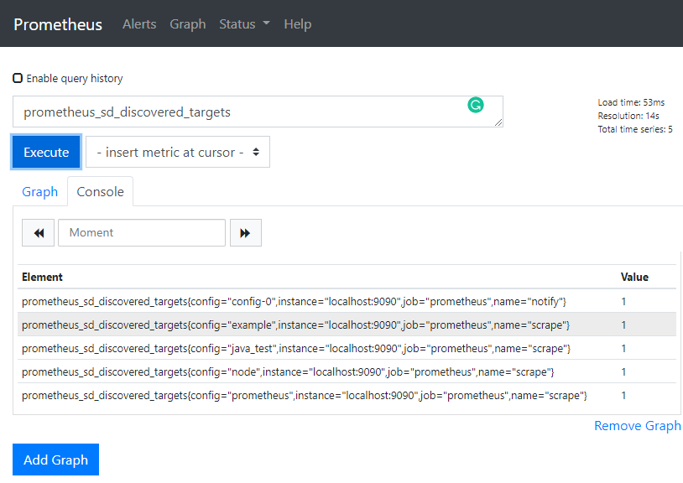
Exposition
Labels
Instance – Usually some entity
Job – The Prometheus scrape Job that produced this metric
Can add other custom labels – such as region, environment
Notes:
Instance and Job are coordinates that every label must have. Together with the metric name, they define a unique metric
You can also add any labels in your job config, and these labels would be added to every metric scraped during that job
It is possible to filter out some labels in a metric (if not of interest, to reduce label cardinality) as well as relabel (eg if difference jobs export the same label under different name, eg size vs queueSize), and even drop particular metrics altogether

Slide 12
PromQL
PromQL (Prometheus Query Language) – lets user select and aggregate time series data in real time.
Result can be:
Viewed as a graph or tabular data in Prometheus's expression browser
Displayed in Grafana
Consumed by external systems via the HTTP API
Notes:
https://prometheus.io/docs/prometheus/latest/querying/api/

Slide 13
Simple time series selection
request_count would simply return 5
rate(request_count[5m]) would return the per second rate of requests averaged over 5 minutes
avg_over_time(queue_size[5m])
Return all time series with the metric http_requests_total :
http_requests_total
Return all time series with the metric and the given job and handler labels:
http_requests_total{job="apiserver", handler="/api/comments"}
Return a whole range of time (in this case 5 minutes) for the same vector, making it a range vector:
http_requests_total{job="apiserver", handler="/api/comments"}[5m]
histogram_quantile(0.90, sum without(code, job, method, os, runtime (rate(http_request_duration_seconds_bucket{code="200"}[5m])))
Notes:
The rate function calculates the per second rate of increase averaged over the provided time interval. It can only be used with counters.
Note that we can’t use the rate function with a gauge, as it only works with values that go up (i.e. counters).
Try sum(without

Slide 14
PromQL
Metric name
Label
Time range
Function
Aggregation
without (groups by those labels)
sum without (job, os, runtime) (rate(logback_events_total{job=“logs”})[5m])
Notes:
The 4 Types Of Prometheus Metrics – Tom Gregory – has great examples of Java client library calls. Lists good general use cases.

Slide 15
Node Exporter
Demo

Slide 16
Web hooks

Slide 17
Demo
http://...:9090/targets
http://...:6577/../prometheus
http://...:9090/graph
Notes:
Look at targets
Configuration
http://psclxd00028:9090/targets
http://eun003741:6577/SYSM/A/counselor/cloud/Prometheus
process_cpu_usage
process_cpu_usage{job="maas-uat-opentsdb-writers"}
process_cpu_usage{job=~“maas.*"}
process_cpu_usage{job="maas-uat-opentsdb-writers", instance=~"am.*"}
deriv(process_cpu_usage{job="maas-uat-opentsdb-writers", instance=~"am.*"}[5m])
sum(deriv(process_cpu_usage{job="maas-uat-opentsdb-writers", instance=~"am.*"}[5m]))
logback_events_total
logback_events_total{instance="wk"} (This is a selector)
logback_events_total{instance="wk“, level=~”warn|error”}
logback_events_total{instance=~"wk|rh", level=~"warn|error"}
logback_events_total{instance=~"wk|rh", level=~"warn|error"}[1m] (Since it scrapes every 15 seconds, we should see 4 metrics per minute
sum(logback_events_total{instance=~"wk|rh", level=~"warn|error"})
rate(logback_events_total{instance=~"wk|rh", level=~"warn|error"}[5m])
sum(rate(logback_events_total{instance=~"wk|rh", level=~"warn|error"}[5m]))

Slide 18
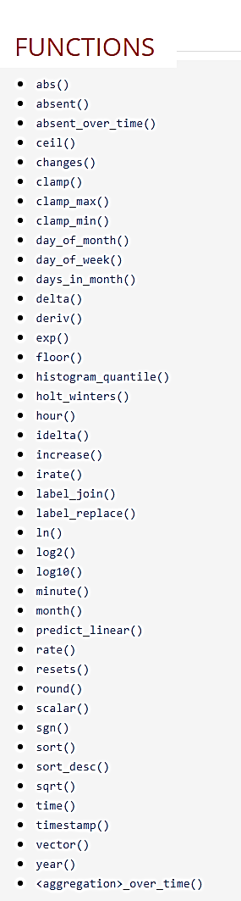
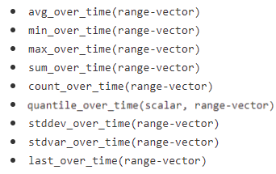
Prometheus Functions
https://prometheus.io/docs/prometheus/latest/querying/functions
Notes:
https://prometheus.io/docs/prometheus/latest/querying/functions

Slide 19
Types of Metrics
Counters – Generally increasing metric
Gauges - Freely varying metric
Histograms – Distribution ranges of a metric
Summaries – Counts and totals of a metric
Notes:
The 4 Types Of Prometheus Metrics – Tom Gregory – has great examples of Java client library calls. Lists good general use cases.

Slide 20
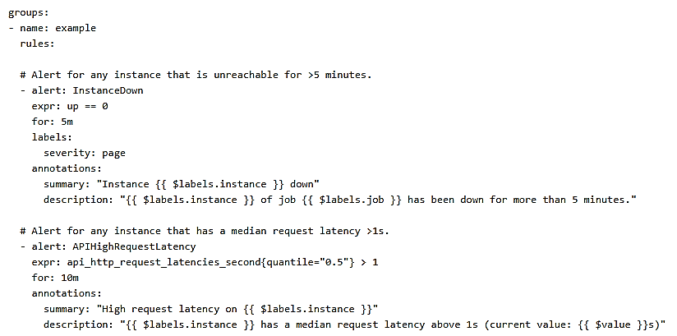
Configuring Alerting Rules

Slide 21
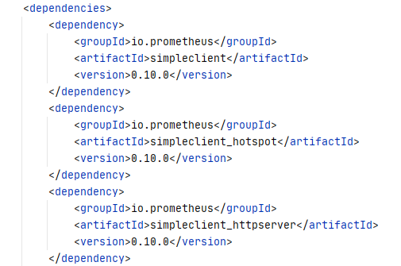
Client Libraries - Java

Slide 22
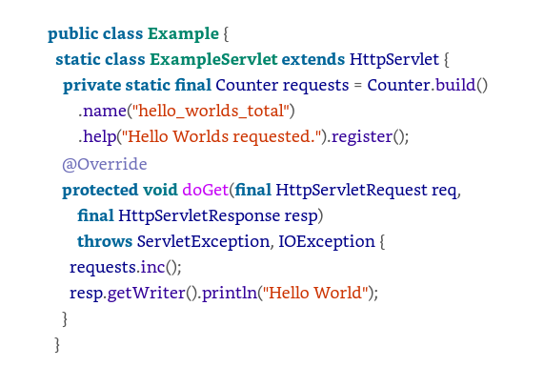
Client Libraries - Java

Slide 23
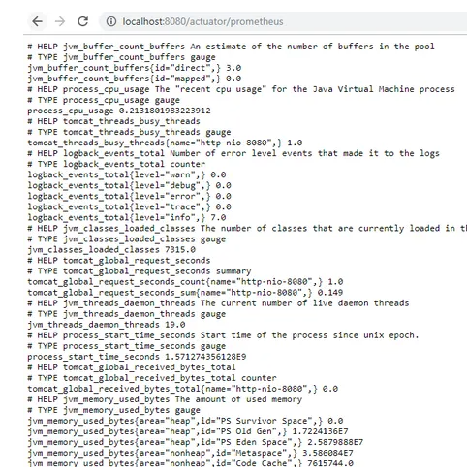
Micrometer
Automatic Metrics Exposition for Spring Boot applications.
Exposes Actuator metrics in Prometheus format.

Slide 24
Grafana
More sophisticated graphing
Demo
Notes:
This is not ratified yet, but it is being considered by the Observability Working Group

Slide 25


The End
The Beginning!
Notes:
This is not ratified yet, but it is being considered by the Observability Working Group

